Slide 1
TEAM TECHNOHOLICS PRESENTS
LIBRARY MANAGEMENT SYSTEM
MEMBERS
TEJ PRATAP
TANYA PARWAL
SHREY BHARDWAJ
VARTIKA CHAURASIA

Slide 2
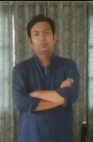
MADE UNDER THE GUIDANCE OF
Our mentor Dr. BP Sharma (sir)

Slide 3
DOMAIN
This project is based on the libraries that
operate offline (in the real world). In this
times of pandemic, no one being able to
go out, an online library is more
accessible to all. Therefore, this project
focuses on managing the library online.

Slide 4
PROJECT DESCRIPTION
Library Management System is a project which aims in developing a computerized system to maintain all the daily work of library.
In this console application, we can do basic library management task such as: add, delete, issue, return and search any book with an additional feature to view the list of all the books.
Book maintenance modules are also included in this system which would keep track of the students using the library. With this computerized system there will be no loss of book record and member record which generally happens when a non-computerized system is used.

Slide 5
While adding any book to the system, a unique ID is auto-generated which helps in easy accessibility. Another unique ID is generated for every student who issues and returns a book to keep an easy track of each book and student.
There is a search window to display the availability of books and keep a record of all the books in the system and an option to delete books from the system.
The system will also be able to calculate total fine to be levied on any student who doesn’t return the issued book on the designated due date.

Slide 6
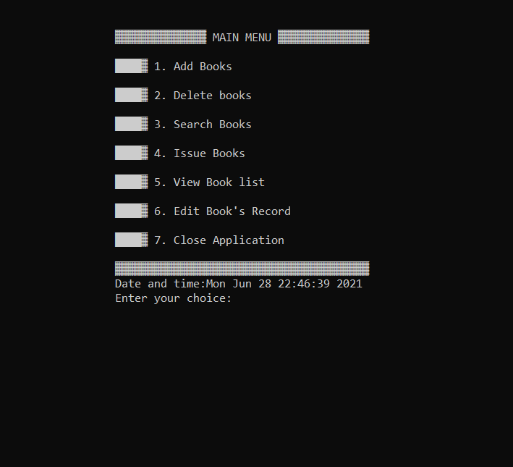
WINDOWS IN OUR SYSTEM
Main Menu
Add books
b) Delete Books
c) Search Books
d) Issue Books
e) View Book List
f) Edit Book’s Record
g) Close Application

Slide 7
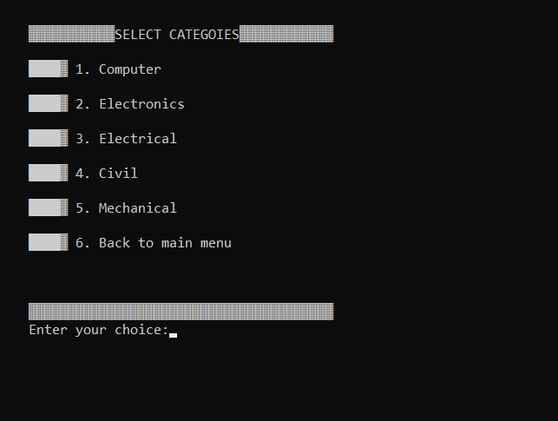
1.1) ADD BOOKS
1.1.1) SELECT BRANCH

Slide 8
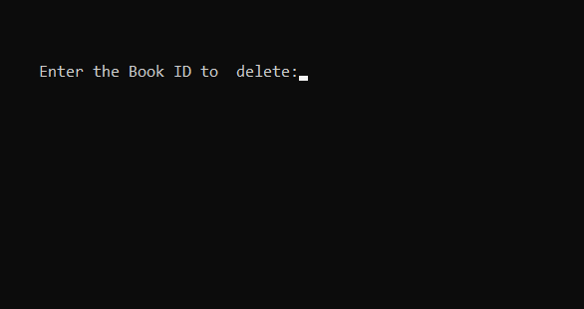
1.2) DELETE BOOKS

Slide 9
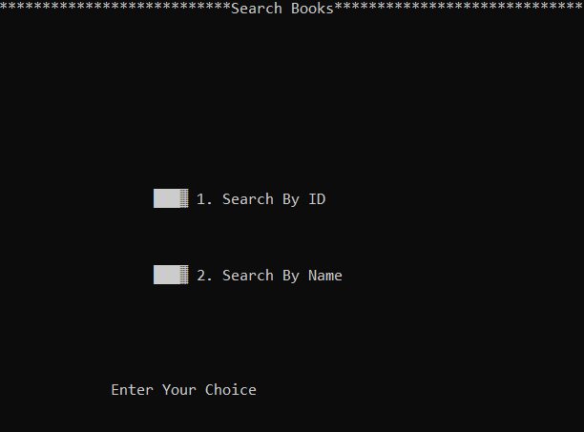
1.3) SEARCH BOOK

Slide 10
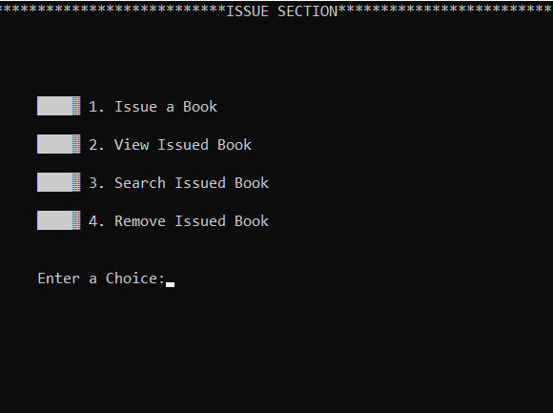
1.4) ISSUE BOOKS
1.4.1) SELECT OPTION
1.4.1.1) ISSUE BOOK
1.4.1.2) VIEW ISSUED BOOK
1.4.1.3) SEARCH ISSUED BOOK
1.4.1.4) REMOVE ISSUED BOOK

Slide 11
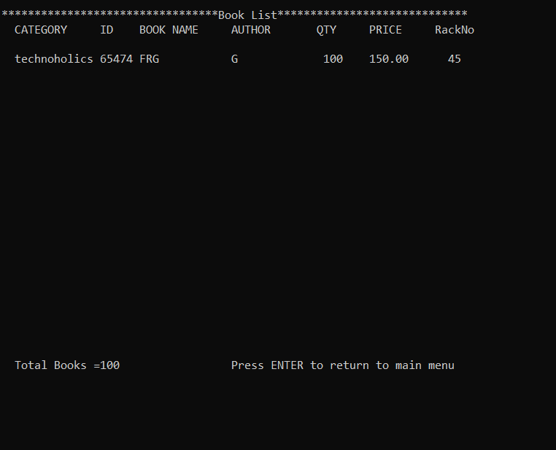
1.5) VIEW BOOK LIST

Slide 12

1.6) EDIT BOOK RECORD

Slide 13
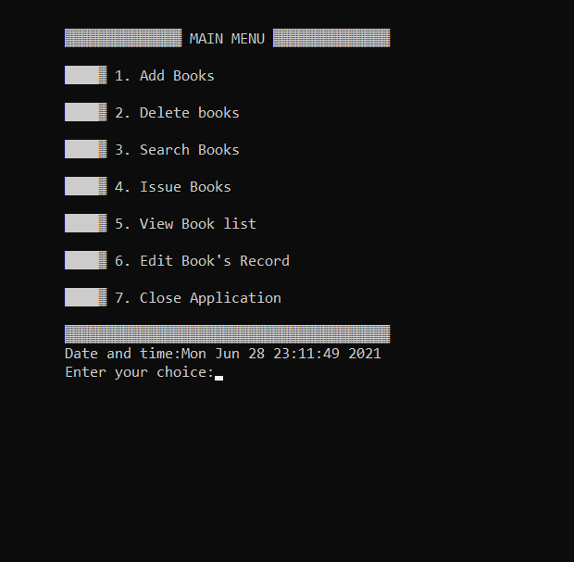
1.7) CLOSE THE APPLICATION

Slide 14
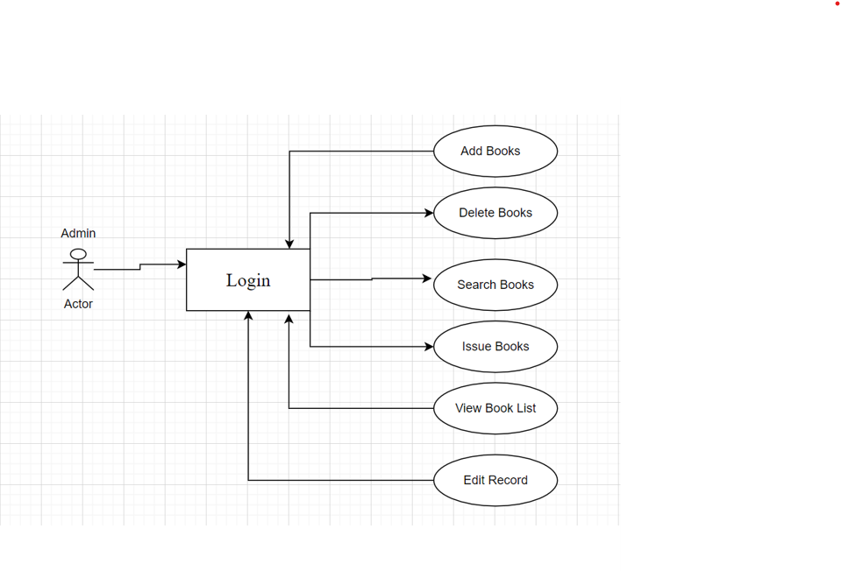
CASE DIAGRAM :

Slide 15
THANK YOU
Any questions?

